Slide 1
Artificial intelligence
Session – 7
Date – 04th June, 2022

Slide 2
Example of resizing the images
There are several ways to resize the image. Below are some examples to perform resize operation:
Retain Aspect Ratio ( height to width ratio of the image is retained)
Downscale(Decrement in the size of the image)
Upscale(Increment in the size of image)
Do not preserve Aspect Ratio
Resize only the width
Resize only the height
Resize the specified width and height

Slide 3
Retain the aspect ratio
Downscale with resize()
import cv2
img = cv2.imread(r’path/cat.jpeg', 1)
print('Original Dimensions : ', img.shape)
scale = 60 # percent of original size
width = int(img.shape[1] * scale / 100)
height = int(img.shape[0] * scale / 100)
dim = (width, height)
# resize image
resized = cv2.resize(img, dim, interpolation=cv2.INTER_AREA)
print('Resized Dimensions : ', resized.shape)
cv2.imshow("Resized image", resized)
cv2.waitKey(0)
cv2.destroyAllWindows()

Slide 4
Retain the aspect ratio
Upscale with resize()
import cv2
img = cv2.imread(r’path\cat.jpeg', 1)
print('Original Dimensions : ', img.shape)
scale = 150 # percent of original size
width = int(img.shape[1] * scale / 100)
height = int(img.shape[0] * scale / 100)
dim = (width, height)
# resize image
resized = cv2.resize(img, dim, interpolation=cv2.INTER_AREA)
print('Resized Dimensions : ', resized.shape)
cv2.imshow("Resized image", resized)
cv2.waitKey(0)
cv2.destroyAllWindows()

Slide 5
Not retaining the aspect ratio
Resize only the width
import cv2
img = cv2.imread(r’path\cat.jpeg', cv2.IMREAD_UNCHANGED)
print('Original Dimensions : ', img.shape)
height = img.shape[0] # keep original width
width = 440
dim = (width, height)
# resize image
resized = cv2.resize(img, dim, interpolation=cv2.INTER_AREA)
print('Resized Dimensions : ', resized.shape)
cv2.imshow("Resized image", resized)
cv2.waitKey(0)
cv2.destroyAllWindows()

Slide 6
Not retaining the aspect ratio
Resize the height
import cv2
img = cv2.imread(r’path\cat.jpeg', 1)
print('Original Dimensions : ', img.shape)
width = img.shape[1] # keep original width
height = 200
dim = (width, height)
# resize image
resized = cv2.resize(img, dim, interpolation=cv2.INTER_AREA)
print('Resized Dimensions : ', resized.shape)
cv2.imshow("Resized image", resized)
cv2.waitKey(0)
cv2.destroyAllWindows()

Slide 7
Resize the specified width and height
We can specify both width and height.
import cv2
img = cv2.imread(r’path\cat.jpeg', 1)
print('Original Dimensions : ', img.shape)
width = 350
height = 450
dim = (width, height)
# resize image
resized = cv2.resize(img, dim, interpolation=cv2.INTER_AREA)
print('Resized Dimensions : ', resized.shape)
cv2.imshow("Resized image", resized)
cv2.waitKey(0)
cv2.destroyAllWindows()

Slide 8
OpenCV Image Rotation
The image can be rotated in various angles (90,180,270 and 360). OpenCV calculates the affine matrix that performs affine transformation, which means it does not preserve the angle between the lines or distances between the points, although it preserves the ratio of distances between points lying on the lines.
The syntax of the rotate image is the following:
cv2.getRotationMatrix2D(center, angle, scale rotated = cv2.warpAfifne(img,M,(w,h))
Parameters:
center: It represents the center of the image.
angle: It represents the angle by which a particular image to be rotated in the anti-clockwise direction.
rotated: ndarray that holds the rotated image data.
scale: The value 1.0 is denoted that the shape is preserved. Scale the image according to the provided value.

Slide 9
OpenCV Image Rotation
import cv2
# read image as greyscale
img = cv2.imread(r'C:\Users\DEVANSH SHARMA\cat.jpeg')
# get image height, width
(h, w) = img.shape[:2]
# calculate the center of the image
center = (w / 2, h / 2)
angle90 = 90
angle180 = 180
angle270 = 270
scale = 1.0
# Perform the counterclockwise rotation holding at the center
# 90 degrees
M = cv2.getRotationMatrix2D(center, angle90, scale)
rotated90 = cv2.warpAffine(img, M, (h, w))
# 180 degrees
M = cv2.getRotationMatrix2D(center, angle180, scale)
rotated180 = cv2.warpAffine(img, M, (w, h))
# 270 degrees
M = cv2.getRotationMatrix2D(center, angle270, scale)
rotated270 = cv2.warpAffine(img, M, (h, w))
cv2.imshow('Original Image', img)
cv2.waitKey(0) # waits until a key is pressed
cv2.destroyAllWindows() # destroys the window showing image
cv2.imshow('Image rotated by 90 degrees', rotated90)
cv2.waitKey(0) # waits until a key is pressed
cv2.destroyAllWindows() # destroys the window showing imag
cv2.imshow('Image rotated by 180 degrees', rotated180)
cv2.waitKey(0) # waits until a key is pressed
cv2.destroyAllWindows() # destroys the window showing image
cv2.imshow('Image rotated by 270 degrees', rotated270)
cv2.waitKey(0) # waits until a key is pressed
cv2.destroyAllWindows() # destroys the window showing image

Slide 10
OpenCV Drawing Functions
We can draw the various shapes on an image such as circle, rectangle, ellipse, polylines, convex, etc. It is used when we want to highlight any object in the input image. The OpenCV provides functions for each shape. Here we will learn about the drawing functions.

Slide 11
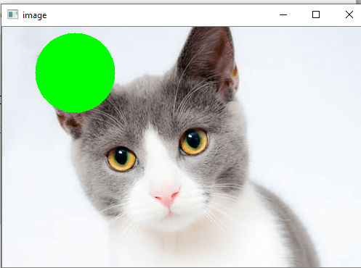
OpenCV Drawing Functions
Drawing Circle
We can draw the circle on the image by using the cv2.circle() function. The syntax is the following:
cv2.circle(img, center, radius, color,thickness, lineType,shift)
Parameters:
img- It represents the given image.
center- Center of the circle
radius- Radius of the circle
color- Circle color
thickness- It denotes the thickness of the circle outline, if it is positive. And negative thickness means that a filled circle is to be drawn.
lineType- Defines the type of the circle boundary.
shift- It represents the number of fractional bits in the coordinate of the center and the radius value.
Consider the following example:
import numpy as np
import cv2
img = cv2.imread(r”path\cat.jpeg",1)
cv2.circle(img,(80,80), 55, (0,255,0), -1)
cv2.imshow('image',img)
cv2.waitKey(0)
cv2.destroyAllWindows()

Slide 12
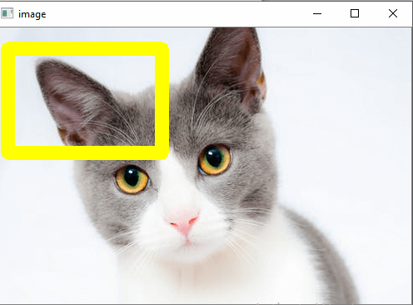
OpenCV Drawing Functions
Drawing Rectangle
The OpenCV provides a function to draw a simple, thick or filled up-right rectangle. The syntax is following:
cv2.rectangle(img, pt1, pt2, color, thickness,lineType,shift)
Parameters:
img- It represents an image.
pt1- It denotes vertex of the rectangle.
pt2- It denotes the vertex of the rectangle opposite to pt1.
color- It denotes the rectangle color of brightness (grayscale image).
thickness- It represents the thickness of the lines that makes up the rectangle. Negative values (CV_FILLED) mean that the function has to draw a filled rectangle.
linetype- It represents the types of the line.
shift- It represents the number of fractional bits in the point coordinates.
Consider the following example:
import numpy as np
import cv2
img = cv2.imread(r“path\cat.jpeg",1)
cv2.rectangle(img,(15,25),(200,150),(0,255,255),15)
cv2.imshow('image',img)
cv2.waitKey(0)
cv2.destroyAllWindows()

Slide 13
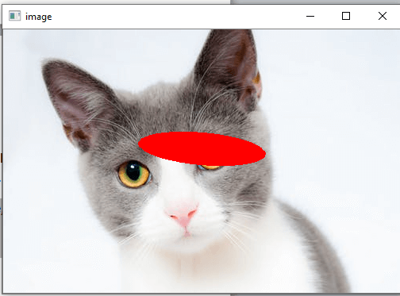
OpenCV Drawing Functions
Drawing Ellipse
We can draw an ellipse on an image by using the cv2.ellipse() function. It can draw a simple or thick elliptic arc or can fill an ellipse sector.
cv2.ellipse(img, center, axes, angle, startAngle, endAngle, color[, thickness[, lineType[, shift]]])
cv2.ellipse(img, box, color[, thickness[, lineType]])
Parameters:
img - It represents an image.
box - It represents alternative ellipse representation via RotatedRect or CvBox2D. It means that the function is used to draws an ellipse in a curved rectangle.
color - It denotes the ellipse color.
angle- It denotes the angle of rotation.
startAngle - It denotes the initial angle of the elliptic arc in degrees.
endAngle - It denotes the ending angle of the elliptic arc in degrees.
thickness - It is used to draw thickness of the ellipse arc outline if the value is positive. Otherwise, this specifies that a filled ellipse is to be drawn.
lineType - It denotes the type of the ellipse boundary.
shift - It represents the number of fractional bits in the coordinates of the center and values of axes.
Consider the following example:
import numpy as np
import cv2
img = cv2.imread(r“path\cat.jpeg",1)
cv2.ellipse(img, (250, 150), (80, 20), 5, 0, 360, (0,0,255), -1)
cv2.imshow('image',img)
cv2.waitKey(0)
cv2.destroyAllWindows()
There are two functions to draw the ellipse. The first function is used to draw the whole ellipse, not an arc bypassing startAngle=0 and endAngle = 360. The second function of an ellipse is used to draw an ellipse outline, a filled ellipse, an elliptic arc, or a filled ellipse sector.

Slide 14
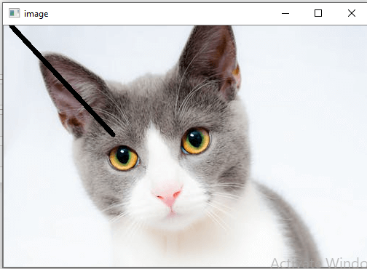
OpenCV Drawing Functions
Drawing lines
OpenCV provides the line() function to draw the line on the image. It draws a line segment between ptr1 and ptr2 points in the image. The image boundary clips the line.
cv2.line(img, pt1, pt2, color[, thickness[, lineType[, shift]]])
Parameters:
img- It represents an image.
pt1- It denotes the first point of the line segments.
pt2- It denotes the second point of the line segment.
color - Represents the Line-color
thickness- Represents the Line thickness
lineType- There are various types of line:
8 (or omitted) - 8 connected lines.
4 - 4-connected line.
CV__AA- antialiased line
shift- It represents the number of fractional bits in the point coordinates.
Consider the following example:
import numpy as np
import cv2
img = cv2.imread(r“path\cat.jpeg",1)
cv2.line(img,(10,0),(150,150),(0,0,0),15)
cv2.imshow('image',img)
cv2.waitKey(0)
cv2.destroyAllWindows()

Slide 15
OpenCV Drawing Functions
Write Text on Image
We can write text on the image by using the putText() function. The syntax is given below.
cv2.putText(img, text, org, font, color)
Parameters:
img: It represents an image
text: It represents a text which we want to write on the image.
org: It denotes the Bottom-left corner of the text string in the image.
font: CvFont structure is initialized using InitFont().
color: Represents the Text color.
Consider the following example.
import numpy as np
import cv2
font = cv2.FONT_HERSHEY_SIMPLEX
# Create a black image.
img = cv2.imread(r“path\cat.jpeg",1)
cv2.putText(img,'Hack Projects',(10,500), font, 1,(255,255,255),2)
#Display the image
cv2.imshow("image",img)
cv2.waitKey(0)

Slide 16
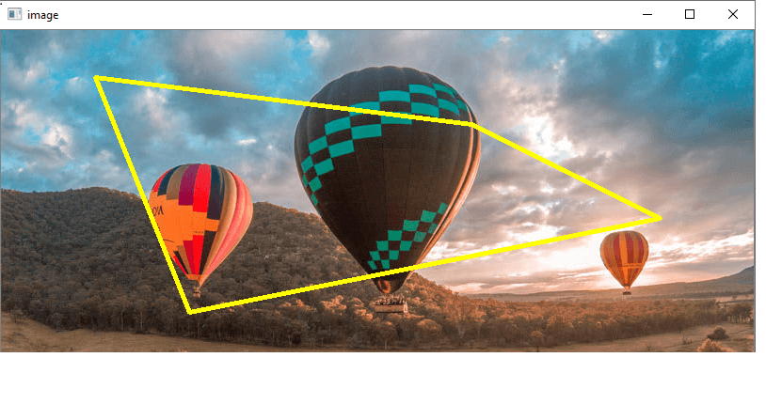
OpenCV Drawing Functions
Drawing Polylines
We can draw the polylines on the image. OpenCV provides the polylines() function, that is used to draw polygonal curves on the image. The syntax is given below:
cv2.polyLine(img, polys, is_closed, color, thickness=1, lineType=8, shift=0)
Parameters:
img - It represents an image.
pts - It denotes the array of polygon curves.
npts - It denotes an array of polygon vertex counters.
ncounters - It represents the number of curves.
is_Closed - It is a flag that indicates whether the drawn polylines are closed or not.
color - Color of polylines.
thickness - It represents the Thickness of the polylines edges.
lineType - Type of the line segment.
shift- It represents the number of fractional bits in the point coordinates.
Consider the following program to draw polylines in image:
import numpy as np
import cv2
img = cv2.imread(r’path\forest.jpg',cv2.IMREAD_COLOR)
#defining points for polylines
pts = np.array([[100,50],[200,300],[700,200],[500,100]], np.int32)
# pts = pts.reshape((-1,1,2))
cv2.polylines(img, [pts], True, (0,255,255), 3)
cv2.imshow('image',img)
cv2.waitKey(0)
cv2.destroyAllWindows()

Slide 17
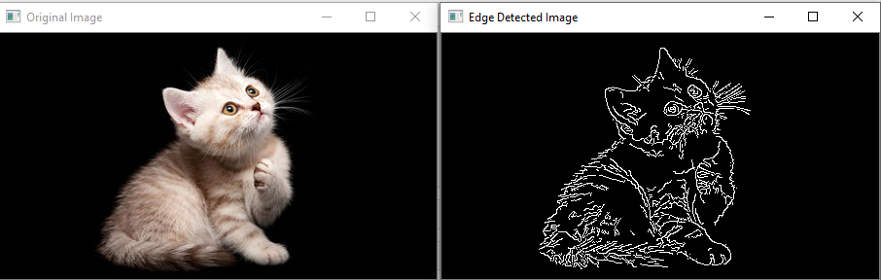
OpenCV Canny Edge Detection
Edge detection is term where identify the boundary of object in image. We will learn about the edge detection using the canny edge detection technique. The syntax is canny edge detection function is given as:
edges = cv2.Canny('/path/to/img', minVal, maxVal, apertureSize, L2gradient)
Parameters-
/path/to/img: file path of the image (required)
minVal: Minimum intensity gradient (required)
maxVal: Maximum intensity gradient (required)
aperture: It is optional argument.
L2gradient: Its default value is false, if value is true, Canny () uses a more computationally expensive equation to detect edges, which provides more accuracy at the cost of resources.
Example: 1
import cv2
img = cv2.imread(r’path\cat_16x9.jpg')
edges = cv2.Canny(img, 100, 200)
cv2.imshow("Edge Detected Image", edges)
cv2.imshow("Original Image", img)
cv2.waitKey(0) # waits until a key is pressed
cv2.destroyAllWindows() # destroys the window showing image

Slide 18
OpenCV Blur (Image Smoothing)
Blurring is the commonly used technique for image processing to removing the noise. It is generally used to eliminate the high-frequency content such as noise, edges in the image. The edges are being blurred when we apply blur to the image. The advantages of blurring are the following:
Advantages of Blurring
The benefits of blurring are the following:
It removes low-intensity edges.
It helps in smoothing the image.
It is beneficial in hiding the details; for example, blurring is required in many cases, such as police intentionally want to hide the victim's face.
OpenCV provides mainly the following type of blurring techniques.

Slide 19
OpenCV Averaging
In this technique, the image is convolved with a box filter (normalize). It calculates the average of all the pixels which are under the kernel area and replaces the central element with the calculated average. OpenCV provides the cv2.blur() or cv2.boxFilter() to perform this operation. We should define the width and height of the kernel. The syntax of cv2.blur() function is following.
cv2.blur(src, dst, ksize, anchor, borderType)
Parameters:
src - It represents the source (input) image.
dst - It represents the destination (output) image.
ksize - It represents the size of the kernel.
anchor - It denotes the anchor points.
borderType - It represents the type of border to be used to the output.

Slide 20
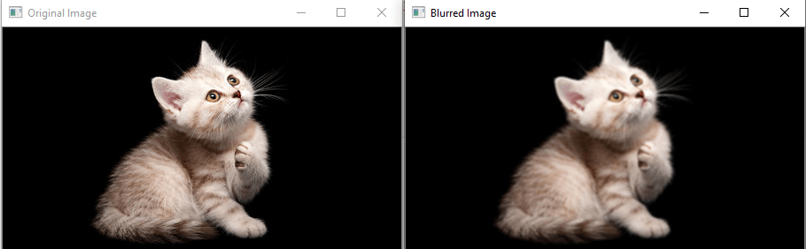
OpenCV Averaging
Consider the following example:
im = cv2.imread(r’path\cat_16x9.jpg')
cv2.imshow('Original Image',im)
cv2.imshow('Blurred Image', cv2.blur(im, (3,3)))
cv2.waitKey(0)
cv2.destroyAllWindows()

Slide 21
OpenCV Gaussian Blur
Image smoothing is a technique which helps in reducing the noise in the images. Image may contain various type of noise because of camera sensor. It basically eliminates the high frequency (noise, edge) content from the image so edges are slightly blurred in this operation. OpenCV provide gaussianblur() function to apply smoothing on the images. The syntax is following:
dst=cv2.GuassiasBlur(src, ksize, sigmaX,dst,sigmaY, borderType=BORDER_DEFAULT)
Parameters:
src -It is used to input an Image.
dst -It is a variable which stores an output Image.
ksize -It defines the Gaussian Kernel Size[height width ]. Height and width must be odd (1,3,5,..) and can have different values. If ksize is set to [0,0], then ksize is computed from sigma value.
sigmaX - Kernel standard derivation along X-axis.(horizontal direction).
sigmaY - Kernel standard derivation along Y-axis (vertical direction). If sigmaY = 0 then sigmaX value is taken for sigmaY.
borderType - These are the specified image boundaries while the kernel is applied on the image borders. Possible border type is:
cv.BORDER_CONSTANT
cv.BORDER_REPLICATE
cv.BORDER_REFLECT
cv.BORDER_WRAP
cv.BORDER_REFLECT_101
cv.BORDER_TRANSPARENT
cv.BORDER_REFLECT101
cv.BORDER_DEFAULT
cv.BORDER_ISOLATED

Slide 22
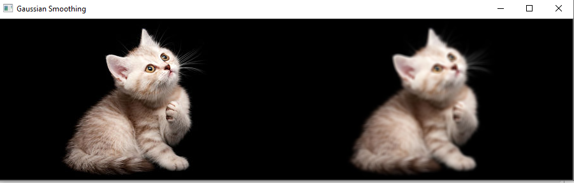
OpenCV Gaussian Blur
Consider the following example:
import cv2
import numpy
# read image
src = cv2.imread(r’path\cat_16x9.jpg', 1)
# apply gaussian blur on src image
dst = cv2.GaussianBlur(src, (5, 5), cv2.BORDER_DEFAULT)
# display input and output image
cv2.imshow("Gaussian Smoothing", numpy.hstack((src, dst)))
cv2.waitKey(0) # waits until a key is pressed
cv2.destroyAllWindows() # destroys the window showing image

Slide 23
OpenCV Median Blur
The median blur operation is quite similar to the Gaussian blur. OpenCV provides the medianblur() function to perform the blur operation. It takes the median of all the pixels under the kernel area, and the central element is replaced with this median value. It is extremely effective for the salt-and-paper noise in the image. The kernel size should be a positive odd integer. Following is the syntax of this method.
cv2.medianBlur(src, dst, ksize)
Parameters:
src- It represents the source (input image).
dst - It represents the destination (output image).
ksize - It represents the size of the kernel.

Slide 24
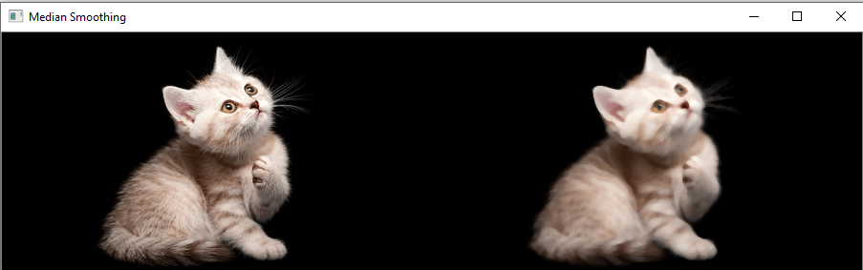
OpenCV Median Blur
Consider the following example:
import cv2
import numpy
# read image
img = cv2.imread(r’path\cat_16x9.jpg', 1)
# apply median blur on src image
dst = median = cv2.medianBlur(img,5)
# display input and output image
cv2.imshow("Gaussian Smoothing", numpy.hstack((src, dst)))
cv2.waitKey(0) # waits until a key is pressed
cv2.destroyAllWindows() # destroys the window showing image

